Slide 1
Boiler Design
Circulating Fluidized Bed Boiler
Dowon SHUN
Korea Institute of Energy Reserch
Notes:
산업용 보일러의 운전특성을 요약하였다.

Slide 2
Boiler Pressure Part

Slide 3
Boiler Units
Economizer; Feed water heater by the heat exchange of low temperature flue gas
Evaporator; Evaporating drum water installed at the hottest part in combustor
Steam drum; Separation of saturated steam from water-steam mixture
Super heater; Further heating of saturated steam by heat exchange with hot flue gas

Slide 4
Water and steam line
50 bar
45 bar
14 bar
13 bar
0.1 bar
263°C
450°C
190°C
320°C
45°C
Superheater
Elec.
Drum
Economizer
143°C
Eva
De-aerator
Condenser

Slide 5
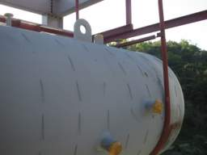
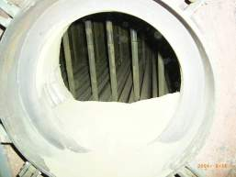
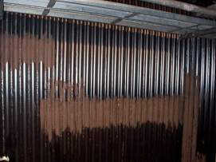
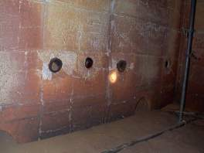
열교환기 배치

Slide 6
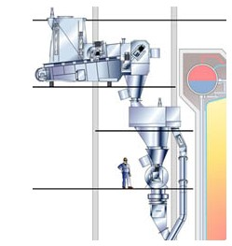
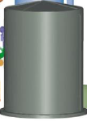

Fluff 전용 RDF 연소 보일러 공정도
Feeding
Boiler island
SDR
Bag filter
Stack
건식 SDR로 소석회와 활성탄을 반응기에 뿌린후 bag filter에서 집진하는 방식

Slide 7
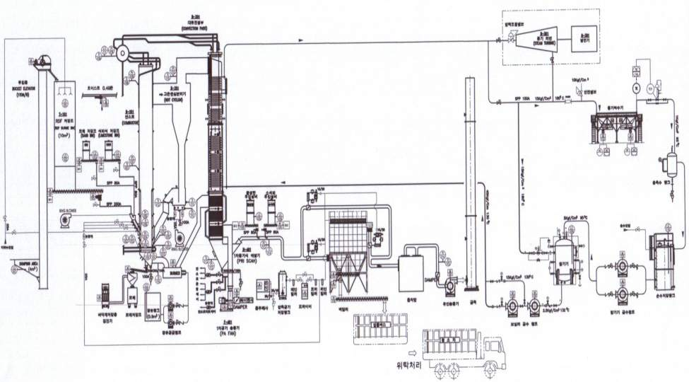
Terminal points

Slide 8
Design of Boiler Parts
Parts | Consideration | Design criteria
Feed water | Feed water pump presure
De-aerator | De-aerator capacity | < 15min
Economizer | Water velocity Exit temperature below boiling temp. | < 0.3m/s > 15C
Drum | Boiler circulation | Water wall bottom Water wall top Riser tube
Evaporator | Water rising velocity | <1m/s
Super heater | Steam velocity | 45~76m/s

Slide 9
Steam
Super heter
Economizer
Evaorator
SNCR
12t/h
220C
245bar
951kJ/kg

Slide 10
Boiler Parts
Economizer; Feed water heater by the heat exchange of low temperature flue gas
Evaporator; Evaporating drum water installed at the hottest part in combustor
Steam drum; Separation of saturated steam from water-steam mixture
Superheater; Further heating of saturated steam by heat exchange of hot flue gas

Slide 11
Heat Transfer in Water Wall
Rule of Thumb
ASH >20% U=140W/m2
Ash <10% U=130W/m2

Slide 12


Heat transfer in convection pass
Parallel array of tubes
(super-heaters)
d
S1
$$σ_{1}=\frac{S_{1}}{d}$$
S2
$$σ_{2}=\frac{S_{2}}{d}$$
Z

Slide 13
Heat transfer in convection pass
Triangle array
(economizer, air heater)
~50% higher heat transfer coefficient
d
S1
S2’
S2
Z

Slide 14
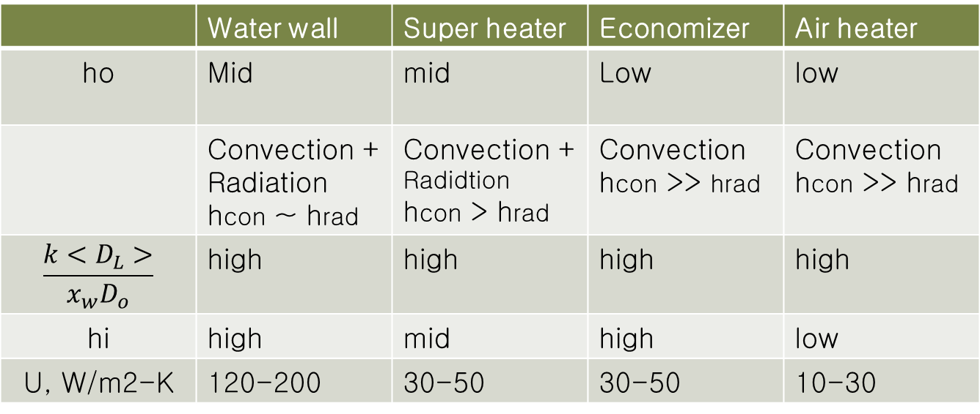
Local heat transfer coefficient
 | Water wall | Super heater | Economizer | Air heater
ho | Mid | mid | Low | low
 | Convection + Radiation hcon ~ hrad | Convection + Radidtion hcon > hrad | Convection hcon >> hrad | Convection hcon >> hrad
$$\frac{k<D_{L}>}{x_{w}D_{o}}$$ | high | high | high | high
hi | high | mid | high | low
U, W/m2-K | 120-200 | 30-50 | 30-50 | 10-30

Slide 15
Convection pass layout
Section | Actual gas velocity [m/s]
Super heater | 10 ~ 14
Economizer | 7 ~ 10
Air heater | 9 ~ 11
Arrangement of tubes and theır pıtches are adjusted to ensure gas velocıty
Super heater pıtch horızontal 100mm vertıcal 100mm.

Slide 16
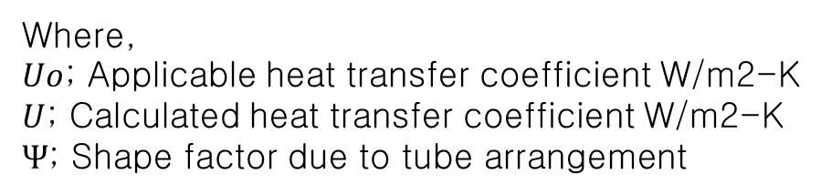

Heat transfer in convection pass
Boiler parts | ψ | Comment
Super heater | 0.6 ~ 0.7 | Little ash layer
Wall super heater | 0.5 | Flue gas stream is blocked by baffle
Economizer | 0.55 ~ 0.65
Air heater | 0.75 ~ 0.8
$$Uo= Ψ×U$$
Where,
$Uo$; Applicable heat transfer coefficient W/m2-K
$U$; Calculated heat transfer coefficient W/m2-K
$Ψ$; Shape factor due to tube arrangement

Slide 17
Material issue
Tube material
ANSI/JIS/KS PIPE Thickness Sch. No.
Material comparison

Slide 18
Material List (ASME SEC. II)
ASTM | DIN |  | USE
SA210A | DIN 2391 St 45.2 GBK | Seamless Medium-Carbon Steel Boiler and Super-heater Tubes | Water wall tubes
SA178C | DIN 17175 St. 35.8 | Electric-Resistance-Welded Carbon | Air heater pipe/Air distributor pipe
SA106B | DIN 17175 St. 45.8 | Seamless Carbon Steel Pipe for High-Temperature Service | Steam/Water header
SA335 P22 | DIN 17175 10CrMo9 10 | Seamless Ferritic Alloy steel for high temperature Service | Super heater coil tubes
SA213 TP347 | DIN2464 10CrNiNb 18 10 | Seamless Ferritic and Austenitic Alloy Steel Boiler tube | Super heater coil tubes
SA213 T12 | DIN 17175 13CrMo44 | Seamless Ferritic and Austenitic Alloy Steel Boiler tube | Super heater header

Slide 19






key elements in tubes
Hardness, Edge Retention, too much can make the steel brittle and increases proneness to corrosion.
Corrosion Resistance, too much can reduce toughness
Toughness, Wear Resistance
Promote overall hardness
toughness which reduces the likelihood of chipping
Toughness, also reduces corrosion

Slide 20
Selection of Boiler tubes
 | IN | Diameter(O.D.) | SCH | Thickness (tm) | Pitch (Hori) | Pitch (Vert) | Material
 |  | mm |  | mm | mm | mm
Feed water | 4 | 114.3 | 80 | 8.6 |  |  | A106B
Eco. Inlet header |  | 219.1 | 120 | 12.7 |  |  | A106B
Economizer coil tube |  | 32 | G8 | 4.2 | 90 | 80 | A210
Eco. Outlet Headers | 8 | 219 | 120 | 18.2 |  |  | A106B
ECO->Drum Feeder | 4 | 114.3 | 80 | 8.6 |  |  | A106B
Drum |  | 1500 |  | 60 |  |  | A515 GR70
Downcomer | 12 | 323.9 | 80 | 17.4 |  |  | A106B
Supplier | 6 | 168.3 | 80 | 11 |  |  | A106B
Down comer drain | 1 | 33 |  | 4.5 |  |  | carbon st.
W/W Inlet Headers | 8 | 219 | 120 | 18.2 |  |  | A106B
Water wall tube | 2 | 60.5 | 80 | 5.5 |  | 88 | A210
Fins |  |  |  | 6 |  |  | SS400
W/W Outlet Headers | 8 | 219 | 120 | 18.2 |  |  | A106B
Riser -> Drum | 6 | 168.3 | 80 | 11 |  |  | A106B
Floor wall water tube | 2 | 60.5 | 80 | 5.5 |  |  | A210
Plate |  |  |  | 6 |  |  | SS400
Drum->Wall SH | 6 | 168.3 | 80 | 11 |  |  | A106B

Slide 21
Selection of Boiler tubes
 | IN | Diameter(O.D.) | SCH | Thickness (tm) | Pitch (Hori) | Pitch (Vert) |  | Material
 |  | mm |  | mm | mm | mm
Wall S/H Side Inlet Headers |  | 219 | 120 | 18.2 |  |  |  | A106B
Superheater 1A Front&Rear |  | 45 |  | 5 |  | 100 | Tube | A210
Superheater 1A Sides |  | 38 | G8 | 4.2 |  |  | Tube
Wall S/H lower Headers | 8 | 219 | 120 | 18.2 |  |  |  | A106B
Front lower Headers | 8 | 219 | 120 | 18.2 |  |  |  | A106B
Ring header | 8 | 219 | 120 | 18.2 |  |  |  | A106B
S/H 1B inlet header | 8 | 219 | 120 | 18.2 |  |  |  | A106B
Superheater 1B |  | 38.1 | G8 | 4.2 | 90 | 60 | Tube | SA335P22
S/H 1B outlet header | 8 | 219 | 100 | 15.1 |  |  |  | SA213T12
Desuperheater | 8 | 219 | 80 | 15.1 |  |  |  | SA213T12
Hanger tube |  | 0.032 | G8 | 4.2 |  |  | Tube | A210
S/H 2 Inlet header | 8 | 219 | 100 | 15.1 |  |  |  | SA213T12
Superheater 2 |  | 38.1 | G8 | 4.2 | 90 | 60 | Tube | SA335P22
SH2 Outlet Header | 8 | 219 | 100 | 15.1 |  |  |  | SA213T12
Air heater pipe | 2 | 60.5 |  | 3.9 | 90 | 80 |  | A178A
Air nozzle tube | 1 | 38 |  | 4.5 |  |  |  | A178C

Slide 22
Water/steam velocity
Tube types | Ref. and basis | Min vel. | Max vel.
Superheated steam | Main steam
 | 25-200mm | 45 | 76
 | >200mm |  | 76
Saturated steam | >1.75kg/cm2 carbon steel
 | 25-200mm | 30 | 48
 | 25-200 |  | 48
Down comer |  | 3.5 | 4.5
Riser |  | 2.5 | 5
Water wall rise velocity |  | 1
Feed water upstream |  | 1 | 2
Feed water pump down stream | 50-175mm | 4.6 | 7.3
 | >175mm |  | 7.3
Condenser pump downstream | 50-175mm | 2.8 | 4.6
 | >175mm |  | 4.6
Condenser cooling water down stream | 275-475mm | 1.9
 | 475-800mm | 1.9 | 3
 | >800mm |  | 3
Cooling water inlet | 25-275mm | 0.9 | 2.2
 | >275 |  | 2.2
Cooling water exit | 25-275mm | 1.2 | 3
 | >275mm |  | 3

Slide 23
Boiler capacity vs. Steam quality

Slide 24
DrumDrain
CBD V/V
2nd-Pass 전벽
하부 Header Drain
To 감온수
ECO 입구 Drain
T
T
From 인산주입 Pump
급수
To Sampling Rack

Slide 25
Water flow circuit
Riser
Drum
Hanger
tubes
Down
comer
Water wall
Economizer
Supplier

Slide 26
Internal Pipe louting (Water)
Drum
Combustor
Convection pass

Slide 27
Steam flow in convection pass
Drum
Rear wall
Front wall
Side wall
To coil

Slide 28
Internal Pipe louting (steam)
Drum
Combustor
Convection pass

Slide 29
NL
H = NL
H = LSL
α
LSL
R
R
β
H = LSLL
LSLL
L

Slide 30
Drum hold up
HSL
NL
HSL; 105% R
LSL; 95% R
LSLL; 5% R
LSL
R
LSLL
L
Q: Why boiler drums should be designed to have a minimum hold up of liquid for a period of 2 minutes between low level trip alarm and empty?
A: This time is needed for just starting the spare feed pump.

Slide 31



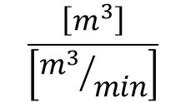



Volume of water in Drum
$$V_{N}=π∙R^{2}∙L/2$$
[m3]
$$LSL=R(1−cos∝)$$
[m]
$$V_{LSL}=R^{2}∙L\left(α−cosα∙sinα\right)$$
$α=\cos^{−1}⁡(\frac{R−LSL}{R}$)
[rad]
H = NL
H = LSL
α
R
β
$$LSLL=R(1−cosβ)$$
H = LSLL
$$V_{LSLL}=R^{2}∙L\left(β−cosβ∙sinβ\right)$$
$$τ=\frac{\left(V_{LSL}{−V}_{LSLL}\right)}{Q}$$
$$\frac{\left[m^{3}\right]}{\left[{m^{3}}/{min}\right]}$$

Slide 32
Drum calculation
NO | Item | Sym | Unit | EQUATIONS | VALUE | Ref.
 | Drum ID |  | mm |  | 1380
 | Drum Length |  | mm |  | 4500
 | Normal level volume |  | m3 |  | 3.4
 | Posing angle of low level |  | deg |  | 30
 |  |  | rad |  | 0.52
 | sin α |  |  |  | 0.5
 | cos α |  |  |  | 0.9
 | Low level height |  | mm |  | 185
 | Low level volume |  | m3 |  | 0.78
 | Volume difference |  |  |  | 2.6
 | Water rate |  | ton/min |  | 1
 | Water volume |  | m3/min |  | 1.2677
 | hold up time NL to LL |  | min |  | 2.04
R
N
α
L

Slide 33
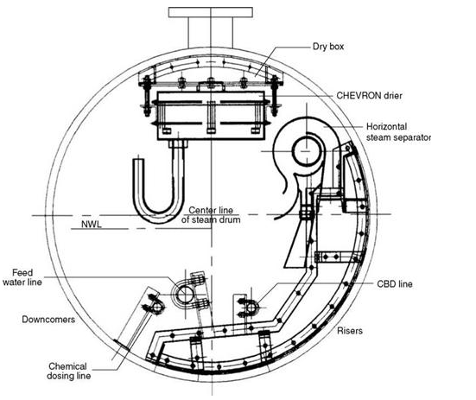
Drum internal

Slide 34
Drum level control
SH2
SH1
Drum
ECO

Slide 35
Down comer layout
Drum
Evaporator upper header
Down comer
elbow(90deg)
elbow(90deg)
elbow(90deg)
Evaporator lower header
elbow(90deg)
Tee
Tee

Slide 36
Down comer pressure layout
Down comer
in
90deg
90deg
out
Evaportor lower header
90deg
90deg

Slide 37
Riser Pressure layout
Drum
90deg
45deg
in
out
45deg
45deg
Evaporator upper header

Slide 38
Drum level gauge min. 2 set
Drum is at saturated condition Temp. sensor not necessary
Pressure part valves
Single valve up to 20bar
Double valve over 40bar

Slide 39
Drain valve
Headers
Equivalvent to Double drain

Slide 40
CBD
Continuous Blow down to remove silicate and recover water
Evaporation
(Recover)
Evaporation
(Vent)
Flash tank
5bara
151℃
Blow down tank
1bara
100 ℃
Drain
Blowdown cooler

Slide 41
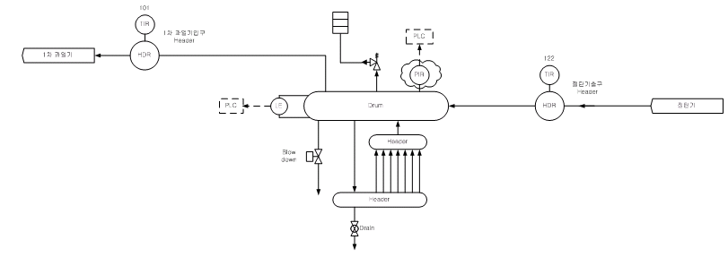
ECO -> Drum -> SH
1st S/H
Drum
ECO
W/W

Slide 42
Water wall
0.05 + 0.09 x 44 +0.0635 + 0.05 = 4.0355
0.05
0.05
Combustor wall

Slide 43
Convection Pass Cage Wall S/H
Width
0.05+0.1x38+0.045+0.05=3.94
0.05
0.05
0.05
Dept
0.05 + 0.1 x 34 +0.04+0.05 = 3.54
0.05
0.05

Slide 44
Super heater
0.09
0.1
0.1
0.1

Slide 45
Super heater tube
50
62
90
38
Super heater tube array

Slide 46
Depth(Side) = 4.4m
0.05
0.05
0.1
0.1+54x0.08+0.03+0.1 =4.55m
54x0.08+0.03=4.35m
4.2m
0.1
Depth(Side Wall)
Economizer

Slide 47
0.1
3.3
0.09
0.06
0.1
0.1
Economizer
Notes:
절탄기

Slide 48
Economizer coil tube Front view
0.08
0.08
0.1
0.08*53+0.03=4.27m
0.1
0.08x17+0.03=3.57m
Per bundle 18 rows
54 columns
Inside width=4.47m

Slide 49
Economizer tube
45
58
70
32
Economizer tube array

Slide 50
2.5
3
7.9
5
13.5
5
Height of Convection Pass

Slide 51
Hanger rod dispatch
Drum
Combustor
Convection pass

Slide 52
Hanger Lug Part
F
W
L
H
C
A
G
D
E
B

Slide 53
Drum Support
L1=450
L2=2300
L2
L1
H=432
L = 5500
M1
M1
M2
e2=882
e1=4600
e2

Slide 54
U-Rod for drum
∆1
∆2
E1=2300
E2
Fixed Point

Slide 55
De superheater

Slide 56

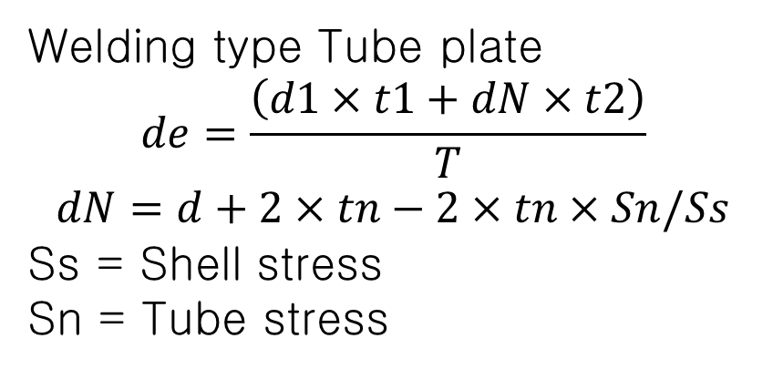
Ligament Efficiency - Parellel (Between Welding type Tube holes)
Welding type Tube plate
$$de=\frac{\left(d1×t1+dN×t2\right)}{T}$$
$$dN=d+2×tn−2×tn×Sn/Ss$$
Ss = Shell stress
Sn = Tube stress
$$EI=(P−d)/P$$

Slide 57
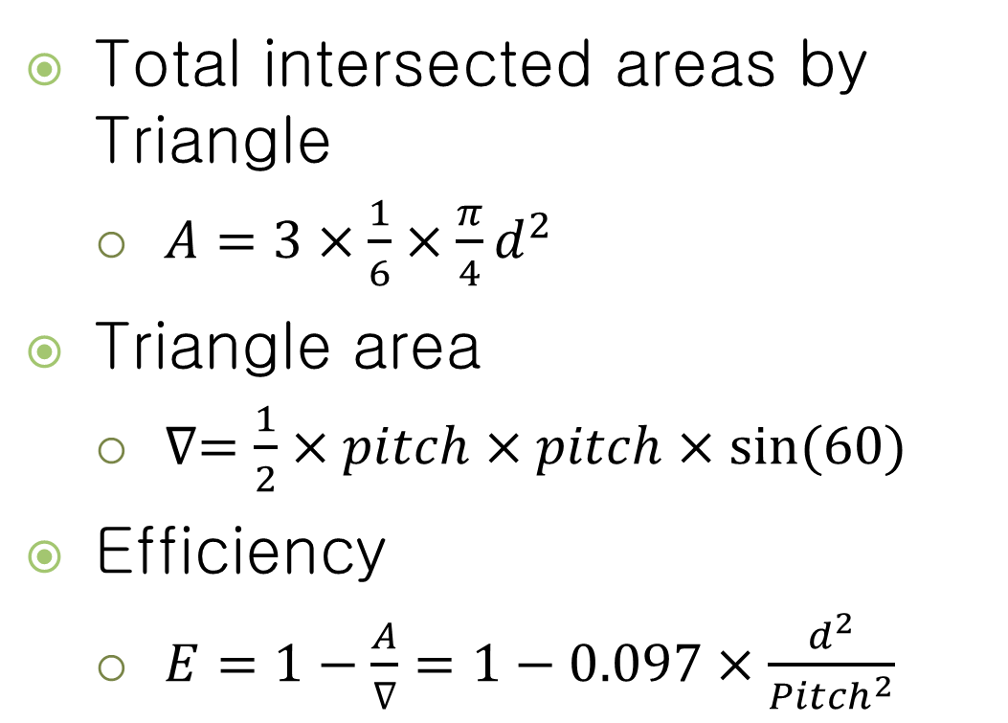
Ligament Efficiency-∇pitch
Total intersected areas by Triangle
$A=3×\frac{1}{6}×\frac{π}{4}d^{2}$
Triangle area
$∇=\frac{1}{2}×pitch×pitch×sin⁡(60)$
Efficiency
$E=1−\frac{A}{∇}=1−0.097×\frac{d^{2}}{{Pitch}^{2}}$
Pitch
D=32

Slide 58
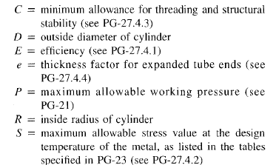
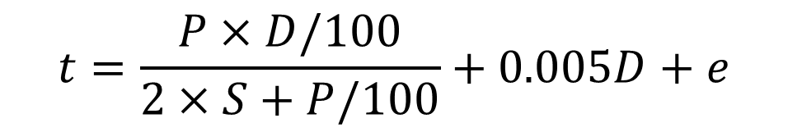
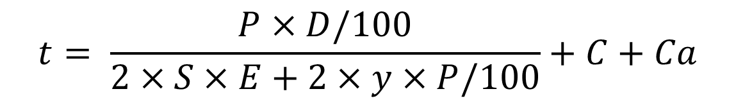
Tube thickness
ASME SECTION-1 PG-27.2.2
$$t= \frac{P×D/100}{2×S×E+2×y×P/100}+C+Ca$$
Header
$$t=\frac{P×D/100}{2×S+P/100}+0.005D+e$$
Tube

Slide 59
Tube thickness
 | Sym | Unit |  | Value
Use |  |  |  | Water wall tube
Material |  |  |  | A210
Nominal Dia. | ND | mm |  | 50
Out. Dia. | OD | mm |  | 60.5
Design Pressure | P | kg/㎠․g |  | 55
Design Temperature |  | ℃ |  | 300
Welding Efficiency | E | Decimal |  | 1
Tolerance | A | mm |  | 1.65
Bending Radius | BR |  |  | -
Manufacturing Tolerance | MT | % |  | 12.5
Maximum allowable Stress | SE | kg/㎠․g |  | 1055
Y value | Y |  | ASME B31.1 Table 104.1.2.A. | 0.4
Bending Coefficients | BC |  |  | 1
Calculated THK | TM | mm | TM = P × OD / (2×(SE+P×Y))+A×BC / (1-MT/100) | 3.4
Req'd THK | TB | mm | TB = TM *BC | 3.4
Final required thickness | T_n | mm | T_n = TB / (1-MT/100) | 3.9

Slide 60
Ash deposit & soot blower
Economizer, re-heater; air heater Ash deposit
Sulfate ash can stick to super heater tubes
Soot blower often malfunctioning
Soot blowers has many accessories; gun, steam line requires maintenance
New technology; Acetylene injection

Slide 61
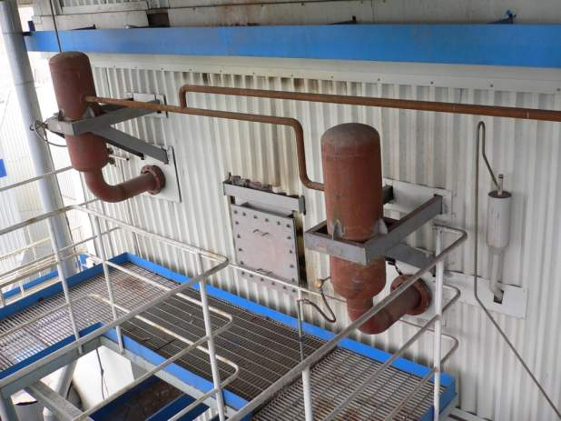
Soot blower
Acetylene injection

Slide 62
Generation of Shock wave

Slide 63
Shock wave generator

Slide 64
감사합니다.

